Slide 1

Sentiment Analysis On User Reviews - Yelp
Karan Desai
Kirty Vedula
Rutgers University

Slide 2
Summary of Last Week
User Review Data Set - 330,000
{ User ID, Business ID, Review Text, Star Rating }
Review-to-rating match
Tagging based on parts of speech
Bi gram approach - dividing the sentences into word-sets of two -[ Adverb + adjective ]
Implement 5-scale rating as opposed to binary
Weight of each review is calculated after summing up the sentiments
Normalizing them according to a formula

Slide 3
Information Retrieval and Sentiment Analysis
Bi-Gram Approach - Example
“not good” , “too good”
good by itself - Positive (1 score)
not good - negate the positive sentiment (-1 score)
too good - boost the positive sentiment (1+1= 2 score)
Parts of Speech Tagging
Input :
nltk.word_tokenize("This restaurant is very good .I love it here")
Output :
[('This', 'DT'), ('restaurant', 'NN'), ('is', 'VBZ'), ('very', 'RB'), ('good', 'JJ'), ('.I’, 'NN'), ('love', 'NN'), ('it', 'PRP'), ('here', 'RB')]
What we need :
('very', 'RB'), ('good', 'JJ')
*RB - ADVERB, *JJ - ADJECTIVE

Slide 4
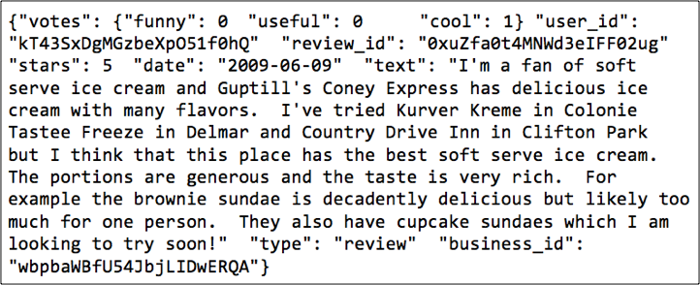
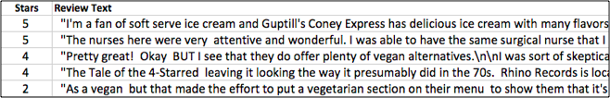
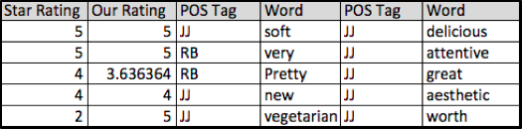
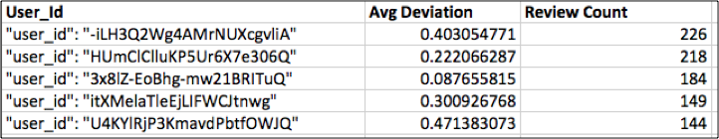
Snapshot of data

Slide 5
Part II : Classification
Supervised learning
Compare the performance with holdout validation
Other techniques including k-fold and leave-one-out cross validation are also available.
Labels - users' ratings
Three algorithms - Naive Bayes, SVM and kNN classifiers
Validation using confusion matrix, ROC, Rate of learning

Slide 6
Flow chart
Calculated weight for each review
Split into training and testing
Training on different classifiers
Testing on different classifiers
Inferences
Results
Cross validation

Slide 7
Supervised learning – classification methods
Partition the data into training set and test set
Training set used to calibrate/train the model parameters
Trained model used to make a prediction on the test set
Predicted values compared with actual data to compute the confusion matrix
Compare the performance with holdout validation – one vs. all
Linear regression, Naïve Bayes, logistic regression, discriminant analysis, SVMs
Confusion matrix and accuracy

Slide 8
Results for multiclass classification
Classification Method | Naïve Bayes Classifier | Logistic Regression | Discriminant Analysis | kNN classifier(Euclidean) | Support Vector Machines
Working | Based on estimating P(X|Y), the probability of features X given class Y | Measures the relationship among variables using prior probability scores | Expresses one dependent variable as linear combination of other features | Categorizing query points based on their distance to points | Classifies data by finding the best hyper-plane that separates all data points of one class from those of the other class
Accuracy | 73.67% | 77.96% | 73.67% | 74.26% | Doesn’t converge
Inference | Assumption of independence Degree of class overlapping is small Sensitive to parameter optimization |  | Very fast, compared to other classifiers | Does not require models Compute distances to all training examples Susceptible to noise in the training data distance measure | sensitive to parameter optimization

Slide 9
Analysis and inferences
One-vs.-all - solves a separate optimization problem for each class (out of 5) simultaneously
Working on a 1-5 scale – randomness is spread widely (as opposed to binary models)
Cannot prefer any classification method if it outperforms others in one context since it might fail severely in another one.
If one class is more likely than the others
Large number of points to capture this distinction – otherwise error
Accuracy inherently limited to the likelihood of the most likely class

Slide 10
Why did SVM fail to converge?
Hard classifiers – no probability involved
Good at binary classification problems
Cannot be easily extended to their multi-class counterparts
Slow to train and complicated to implement
Fail at test instances – given a different data set
Naturally handle large dimensional data

Slide 11
Conclusion & Future Extensions
Conclusion
Our method has a Likert Scale Sentiment Rating compared to binary
Compared to random guessing (20%) we have maximum Probability of 77%
Rating of Users based on their reviews
( A trustworthy online review process)
Future Extensions
Weighted Business Ratings
Estimating Feature Importance – including Principal Component Analysis
Include parallel processing
Increase dimensionality by introducing kernel functions

Slide 12
Individual Contribution
Karan Desai
Data Set Text Manipulation
Parts of Speech Tagging
Gathering Opinion Lexicons
Sentiment Analysis and Custom Review Ratings
Calculating User’s Accuracy Ratings
Kirty Vedula
Building the training and testing datasets
Training and testing the data sets on five different classifiers
Inference and analysis of results

Slide 13
THANK YOU
QUESTIONS ?

